Slide 1
Inventory Management System
August Davis, Christian Hansen, David Erickson

Slide 2
Goals of the project
Ability to scan barcodes of new inventory from a cellphone camera
Organize inventory information in a format that will allow for easy viewing, editing and auditing
Have an easy to use interface
Comprehensive documentation for future developers of the project

Slide 3
Interface
Goals
Final State
Prioritizing Android compatibility using a web-based application.
Easy access to features (login, stored inventory, scanner features)
Compliant with university style guidelines
We were not able to test on mobile
All features are accusable and are easily accessible from the home page
Interface complies with und style guidelines

Slide 4
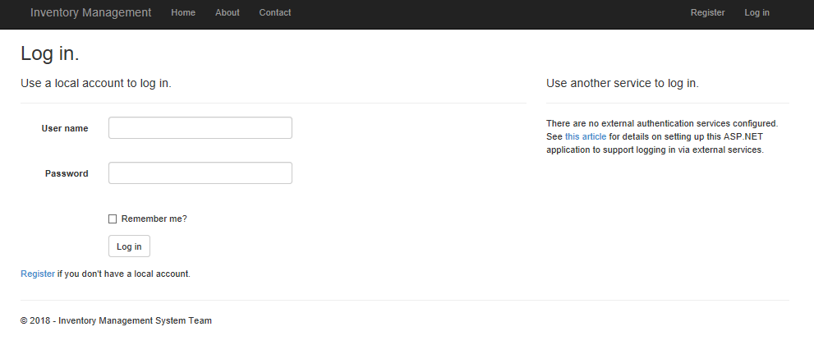

Slide 5
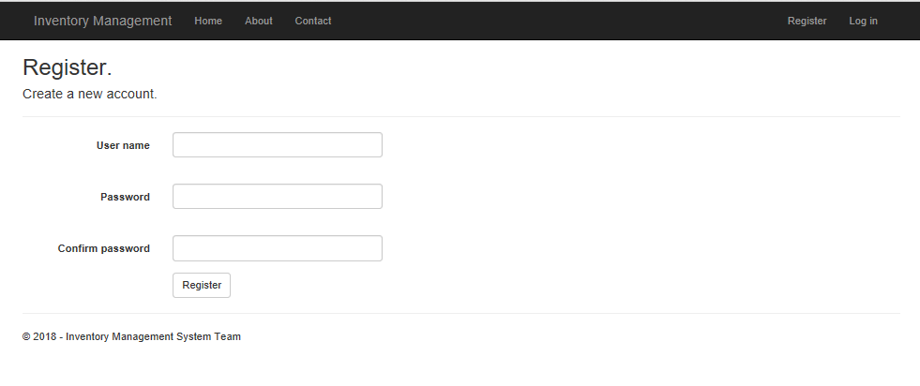

Slide 6
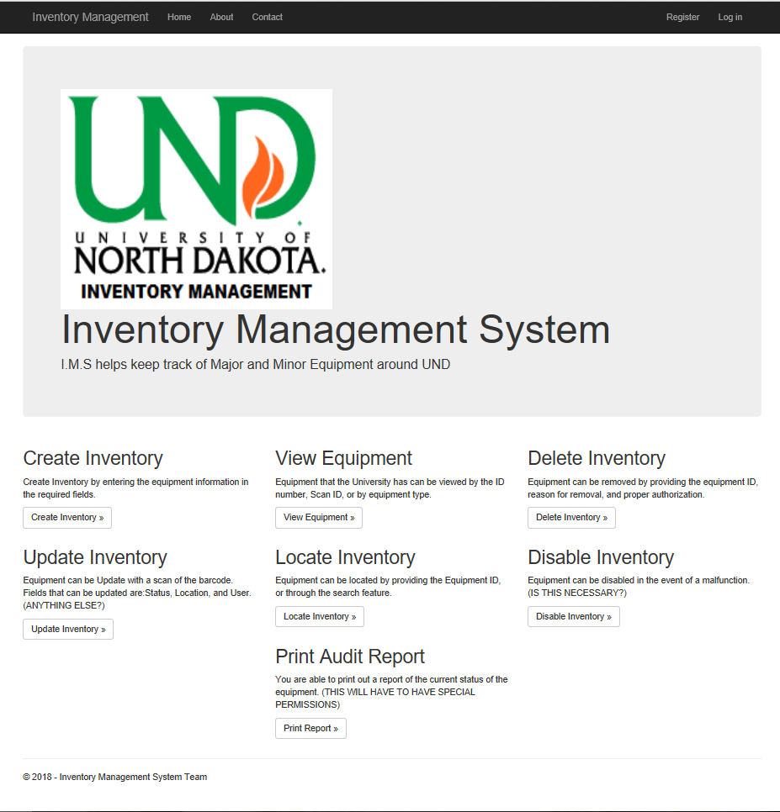

Slide 7
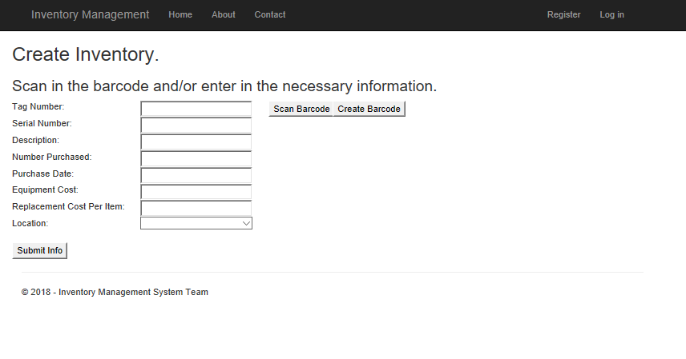

Slide 8
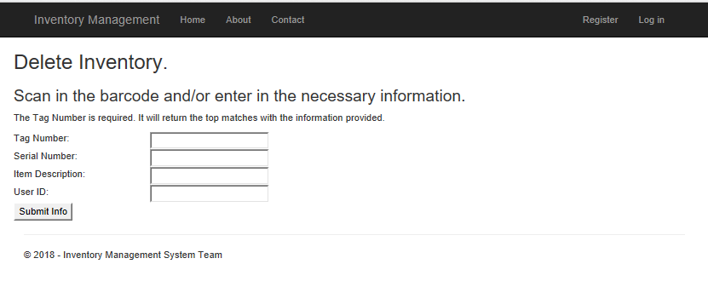

Slide 9
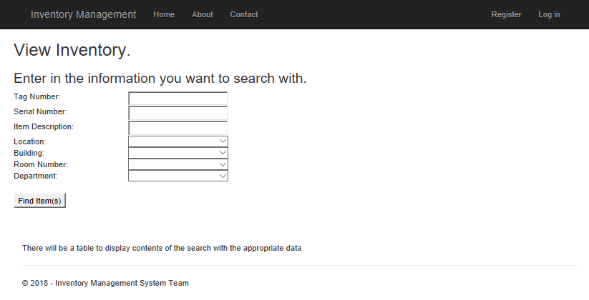

Slide 10
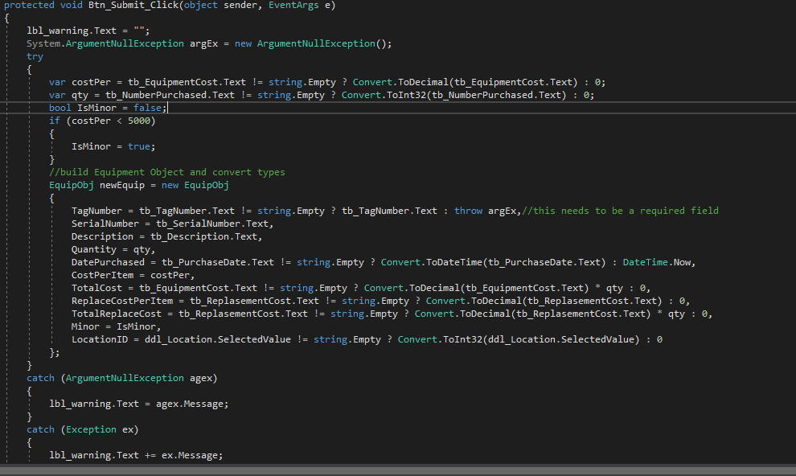

Slide 11
Storage
Goals
Final State
Store all relevant information for inventory items
Allow for easy access and manipulation of stored items
Microsoft SQL Server is used for storage
Tables and server are set up
Website successfully connects to the server when hosted localy

Slide 12
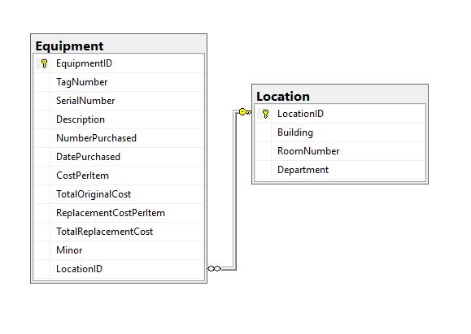
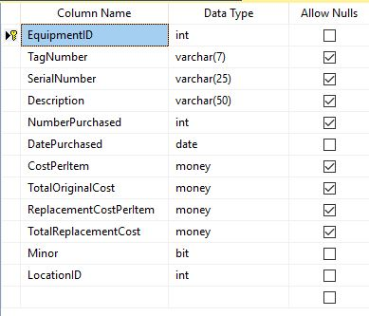

Slide 13
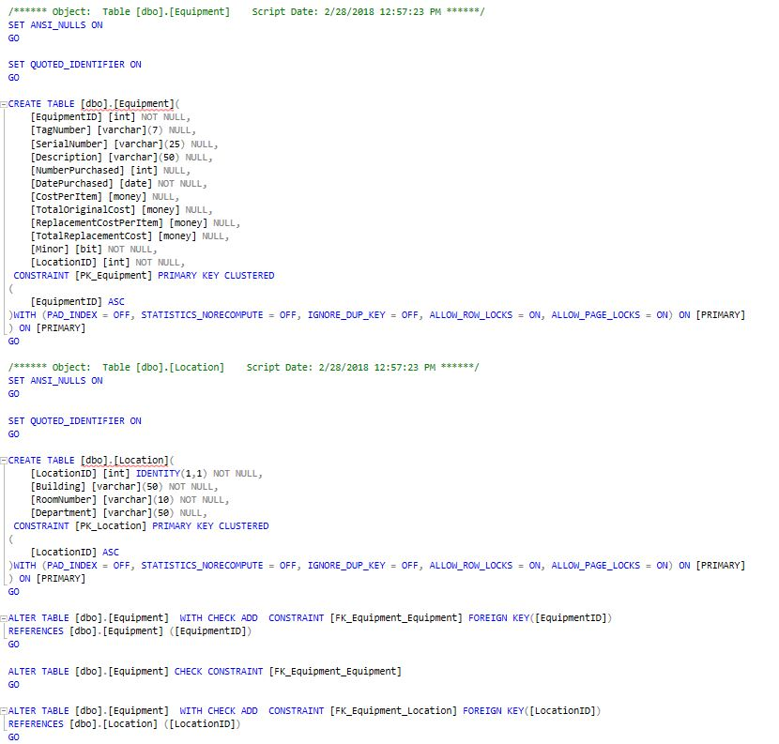

Slide 14
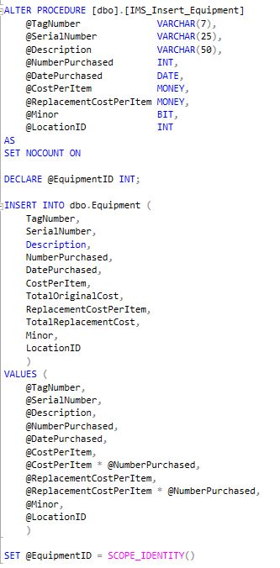

Slide 15
Scanner
Goals
Final State
Scanning the barcodes found on department inventory from a phone camera
Secondary goal: scanning barcodes from a PC
On android scanning is handled by a call to the external app “Barcode Scanner”
On PC scanning is handled by a USB hand scanner
No scanning available on non android phones

Slide 16
Possible future work
Setting up a hosting server
Further optimizing the interface for mobile
Converting the data from the old system to this one
Adding a scanning option for IOS

Slide 17
Finished. Questions?

